Slide 1
Applications of Neural Networks with Long Short Term Memory (LSTM)
Guidance- by- Prof. Dr. Jörg Schäfer 1. shaikh safir Mohammad (1322554) Ms. Fatima butt 2. Yelpale Kshitij (1322509)

Slide 2
Introduction

Slide 3
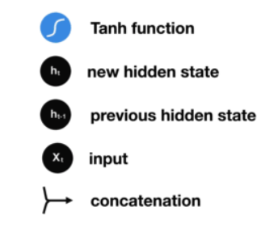
Structure of RNN
Notes:
Phi, M., Medium. 2018. Illustrated Guide to LSTM’s and GRU’s: A step by step explanation. [Blog] Available at: <https://towardsdatascience.com/illustrated-guide-to-lstms-and-gru-s-a-step-by-step-explanation-44e9eb85bf21> [Accessed 11 September 2020].

Slide 4
Vanishing Gradient Problem in RNNs
Notes:
Phi, M., Medium. 2018. Illustrated Guide to LSTM’s and GRU’s: A step by step explanation. [Blog] Available at: <https://towardsdatascience.com/illustrated-guide-to-lstms-and-gru-s-a-step-by-step-explanation-44e9eb85bf21> [Accessed 11 September 2020].

Slide 5
LSTMs mimic Human Memory
Notes:
Phi, M., Medium. 2018. Illustrated Guide to LSTM’s and GRU’s: A step by step explanation. [Blog] Available at: <https://towardsdatascience.com/illustrated-guide-to-lstms-and-gru-s-a-step-by-step-explanation-44e9eb85bf21> [Accessed 11 September 2020].

Slide 6

LSTM Architecture
Notes:
Colah, 2015. Understanding LSTM Networks. [Blog] Colah's Blog, Available at: <http://colah.github.io/posts/2015-08-Understanding-LSTMs/> [Accessed 11 September 2020].

Slide 7
Forget Gate
Notes:
Phi, M., Medium. 2018. Illustrated Guide to LSTM’s and GRU’s: A step by step explanation. [Blog] Available at: <https://towardsdatascience.com/illustrated-guide-to-lstms-and-gru-s-a-step-by-step-explanation-44e9eb85bf21> [Accessed 11 September 2020].

Slide 8
Input Gate
Notes:
Phi, M., Medium. 2018. Illustrated Guide to LSTM’s and GRU’s: A step by step explanation. [Blog] Available at: <https://towardsdatascience.com/illustrated-guide-to-lstms-and-gru-s-a-step-by-step-explanation-44e9eb85bf21> [Accessed 11 September 2020].

Slide 9
Cell State
Notes:
Phi, M., Medium. 2018. Illustrated Guide to LSTM’s and GRU’s: A step by step explanation. [Blog] Available at: <https://towardsdatascience.com/illustrated-guide-to-lstms-and-gru-s-a-step-by-step-explanation-44e9eb85bf21> [Accessed 11 September 2020].

Slide 10
Output Gate
Notes:
Phi, M., Medium. 2018. Illustrated Guide to LSTM’s and GRU’s: A step by step explanation. [Blog] Available at: <https://towardsdatascience.com/illustrated-guide-to-lstms-and-gru-s-a-step-by-step-explanation-44e9eb85bf21> [Accessed 11 September 2020].

Slide 11
Application – Sentiment Analysis
Sentiment Analysis is -
the term which is used very often in web-based business sites, social networks and different fields.
an examination field to analyze people’s subjective sentiments.
More Advanced, Focus on “Beyond Polarity”

Slide 12
Implementation
Dataset: IMDB Movie Reviews [1]
Data Pre-processing
Library: Keras
Word Embedding: One-Hot representation + Keras encoded Imdb format
Model: (Embedding + Bidirectional(LSTM( )) + Bidirectional(LSTM( )) + Dense)

Slide 13
Performance Measures
 | # Epochs | Training Accuracy | Validation Accuracy
LSTM (Trained on Custom IMDB Dataset with One-Hot Encoding) | 15 | 99.85 % | 81.29 %
LSTM (Trained on Keras’ IMDB Dataset) | 3 | 85.42 % | 82.81 %
Bi-LSTM (Trained on Keras’ IMDB Dataset) | 2 | 89.98 % | 86.89 %

Slide 14
Problems / Challenges
Context
Irony
Sarcasm
Emojis (:D, ¯ \ _ (ツ) _ / ¯ etc.)
Definition of Neutral
Overfitting
Large difference between training and validation accuracy
Keras’ feature updates!

Slide 15
Results - Correlation
Performed correlation test –
between predicted values of LSTM and actual sentiments
on 4500 documents (sentiments)
Correlation Coefficient Test | LSTM and Actual sentiment
Pearson | 0.882
Spearman Rank | 0.886

Slide 16
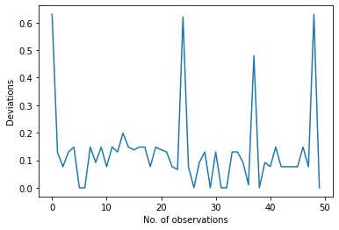
Results – Characteristic Values
Deviations | LSTM and User sentiment
Mean | 0.133
Standard Deviation | 0.147

Slide 17
Thank you!

Slide 18
References
[1] Andrew L. Maas, Raymond E. Daly, Peter T. Pham, Dan Huang, Andrew Y. Ng, and Christopher Potts. (2011). Learning Word Vectors for Sentiment Analysis. The 49th Annual Meeting of the Association for Computational Linguistics (ACL 2011).

